Slide 1
CS118 – Programming Fundamentals
Lecture # 13
Monday, October 09, 2019
FALL 2019
FAST – NUCES, Faisalabad Campus
Course Instructor:
Ebad Majeed
Slides Credit:
Rizwan Ul Haq

Slide 2

do…while Looping (Repetition) Structure
General form of a do...while:
The statement executes first, and then the expression is evaluated
To avoid an infinite loop, body must contain a statement that makes the expression false
The statement can be simple or compound
This loop is post-test loop
Loop always iterates at least once

Slide 3
do…while Looping (Repetition) Structure (cont'd.)
Statements
Expression
true
false
do-while loop

Slide 4
do…while Looping (Repetition) Structure
number = 0;
do
{
cout << number << " " ;
number = number + 5 ;
}
while ( number <= 20) ;
The output of this code is:
0 5 10 15 20
After 20 is output, the statement:
number = number+5
Changes the value of number to 25 so number <= 25 becomes false, which stops the loop

Slide 5
do…while Looping (Repetition) Structure
Consider the following two loops:
a. i = 11
while(i <= 10)
{
cout << i << " " ;
}
cout << endl ;
b. i = 11 ;
do
{
cout << i << " " ;
i = i + 5 ;
}
while ( i <= 10);
cout << endl;
In (a), the while loop produces nothing. In (b), the do…while loop outputs the number 11 and also changes the value of i to 16

Slide 6
do…while Looping (Repetition) Structure
int score ;
do
{
cout << "Enter a score between 0 and 50: " ;
cin >> score ;
cout << endl ;
}while (score > 0 && score < 50);

Slide 7
Example 5-20: Divisibility Test by 3 and 9
sum = 0;
do
{
sum = sum + num % 10 ; //extract the last digit
//and add it to sum
num /= 10 ; //remove the last digit
}while(num > 0);
cout << "The sum of the digits = " << sum << endl ;
if(sum % 3 == 0)
cout << sum << "is divisible by 3" << endl ;
else
cout << sum << " is not divisible by 3 " << endl ;
if (sum % 9 == 0)
cout << sum << "is divisible by 9" << endl ;
else
cout << sum << " is not divisible by 9" << endl ;

Slide 8
Choosing the Right Looping Structure
All three loops have their place in C++
If you know or can determine in advance the number of repetitions needed, the for loop is the correct choice
If you do not know and cannot determine in advance the number of repetitions needed, and it could be zero, use a while loop
If you do not know and cannot determine in advance the number of repetitions needed, and it is at least one, use a do...while loop

Slide 9
break and continue Statements
break and continue alter the flow of control
break statement is used for two purposes:
To exit early from a loop
Can eliminate the use of certain (flag) variables
To skip the remainder of the switch structure
After the break statement executes, the program continues with the first statement after the structure

Slide 10
break and continue Statements
continue is used in while, for, and do…while structures
When executed in a loop
It skips remaining statements and proceeds with the next iteration of the loop

Slide 11
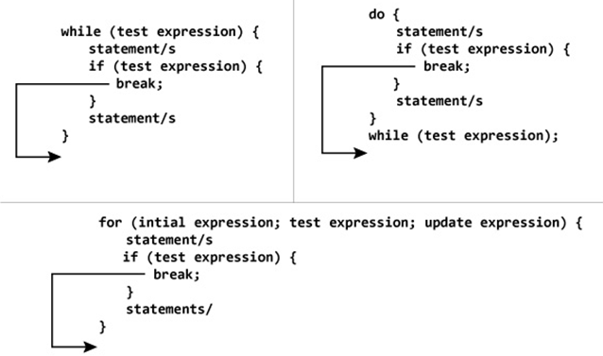
break Statement

Slide 12
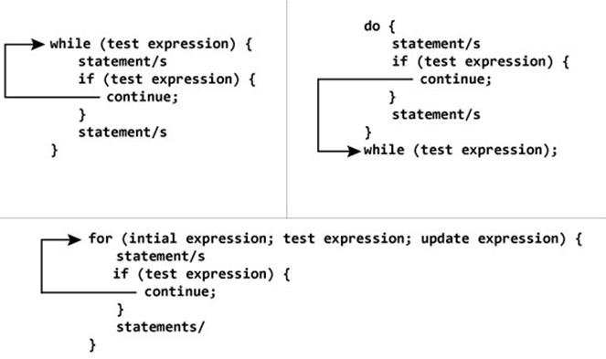
continue Statement

Slide 13
Example
int sum = 0;
bool isNegative = false;
int num ;
cin >> num;
while (cin && !isNegative)
{
if(num < 0) //if num is negative, terminate the loop
//after this iteration
{
cout << "Negative number detected " << endl;
isNegative = true;
}
else
{
sum = sum + num;
cin >> num;
}
}

Slide 14
break Statement Example
int sum = 0;
int num ;
cin >> num;
while (cin)
{
if(num < 0) //if num is negative, terminate the loop
{
cout << "Negative number detected " << endl;
break ;
}
else
{
sum = sum + num;
cin >> num;
}
}

Slide 15
continue Example
int sum = 0;
int num ;
cin >> num;
while (cin)
{
if(num < 0)
{
cout << "Negative number detected " << endl;
cin >> num ;
continue;
}
sum = sum + num;
cin >> num;
}

Slide 16
continue Example
for (int i = 0; i < 100; ++i)
{
// Skip all the multiples of 7
// Operator % calculates the modulus (remainder)
// of a division; if (i % 7) is equal to zero
// this means that i is a multiple of 7.
if ((i % 7) == 0)
continue;
cout << i << " ";
}

Slide 17
Questions

